Slide 1
Object Oriented Programming - Java
- Vasanth S
GeeksGod

Slide 2
What is OOP? Why OOP?
OOP stands for Object-Oriented Programming.
Procedural programming is about writing procedures or methods that perform operations on the data, while object-oriented programming is about creating objects that contain both data and methods.
Object-oriented programming has several advantages over procedural programming:
OOP is faster and easier to execute
OOP provides a clear structure for the programs
OOP helps to keep the Java code DRY "Don't Repeat Yourself”.
OOP makes it possible to create full reusable applications with less code and shorter development time

Slide 3
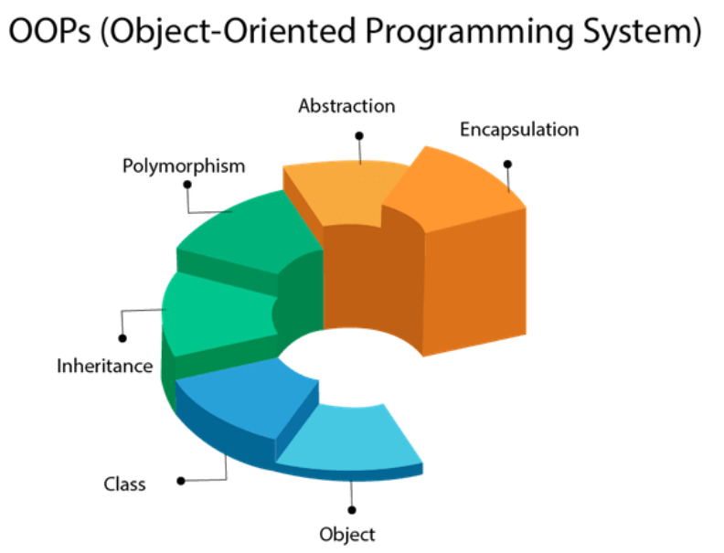
OOPS Concepts

Slide 4
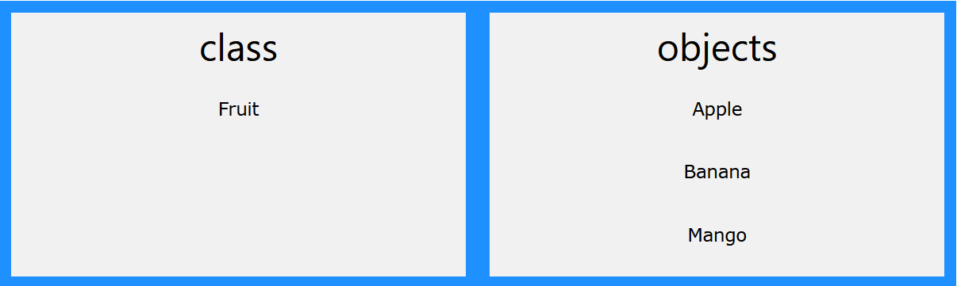
Classes and Objects
Classes and objects are the two main aspects of object-oriented programming.
A class is a user defined blueprint or prototype from which objects are created.
An object is an instance of a class. It is a real world entity.

Slide 5
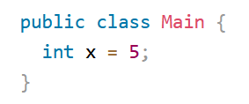
Java - Classes
Modifiers: A class can be public or has default access.
class keyword: class keyword is used to create a class.
Class name: The name should begin with an initial letter (capitalized by convention).
Body: The class body surrounded by braces, { }.

Slide 6
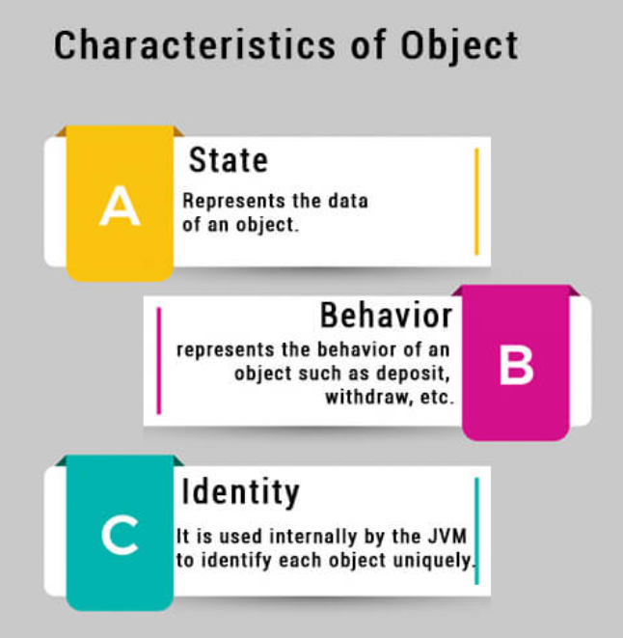
Java - Objects
An entity that has state and behavior is known as an object

Slide 7
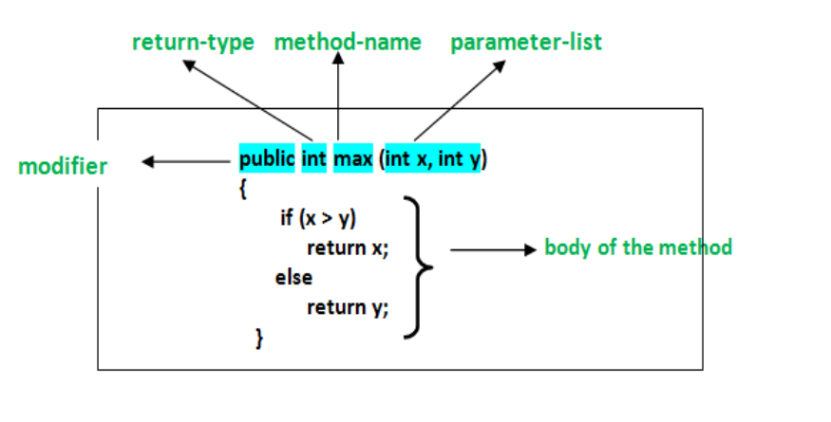
Methods in Java
A method is a collection of statements that perform some specific task and return result to the caller.
Methods allow us to reuse the code without retyping the code.

Slide 8
Message Passing
Objects communicate with one another by sending and receiving information to each other.
A message for an object is a request for execution of a procedure and therefore will invoke a function in the receiving object that generates the desired results.
Message passing involves specifying the name of the object, the name of the function and the information to be sent.

Slide 9
Constructors in Java
It is a special type of method which is used to initialize the object.
Every time an object is created using the new() keyword, at least one constructor is called.
Rules for creating Java constructor
Constructor name must be the same as its class name
A Constructor must have no explicit return type
A Java constructor cannot be abstract, static, final, and synchronized

Slide 10
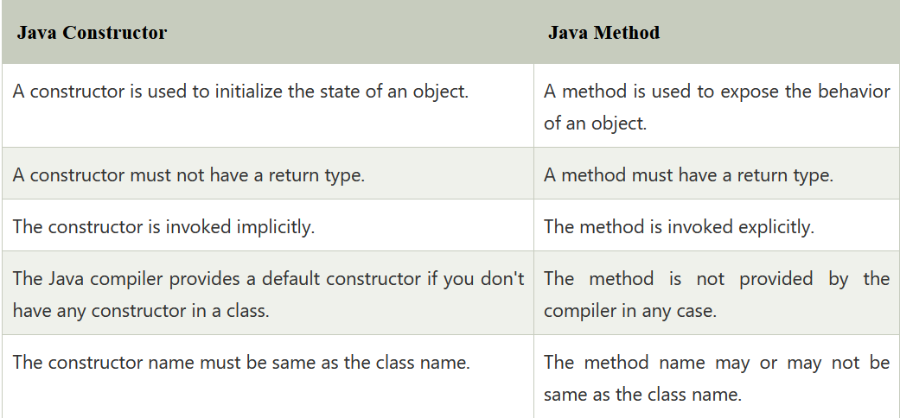
Constructors vs Methods

Slide 11
Encapsulation
It is the mechanism that binds together code and the data it manipulates.
Technically in encapsulation, the variables or data of a class is hidden from any other class and can be accessed only through any member function of own class in which they are declared.
As in encapsulation, the data in a class is hidden from other classes, so it is also known as data-hiding.
Encapsulation can be achieved by Declaring all the variables in the class as private and writing public methods in the class to set and get the values of variables.

Slide 12
Why Encapsulation?
Better control of class attributes and methods
Class attributes can be made read-only (if you only use the get method), or write-only (if you only use the set method)
Flexible: the programmer can change one part of the code without affecting other parts
Increased security of data

Slide 13
Inheritance
It is the mechanism in java by which one class is allow to inherit the features(fields and methods) of another class.
Super Class: The class whose features are inherited is known as superclass(or a base class or a parent class).
Sub Class: The class that inherits the other class is known as subclass(or a derived class, extended class, or child class). The subclass can add its own fields and methods in addition to the superclass fields and methods.
Reusability: Inheritance supports the concept of “reusability”, i.e. when we want to create a new class and there is already a class that includes some of the code that we want, we can derive our new class from the existing class.

Slide 14
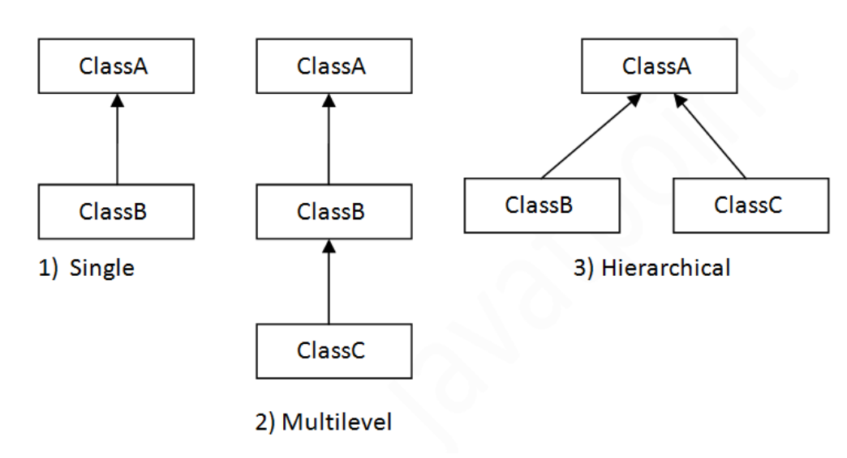
Types of Inheritance

Slide 15
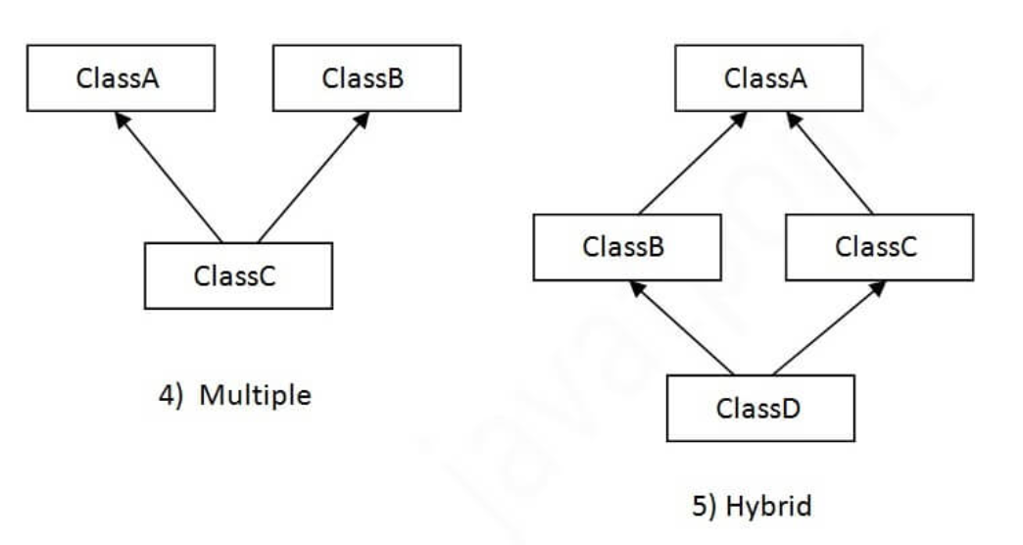
Multiple Inheritance

Slide 16
Why multiple inheritance is not supported in java?
To reduce the complexity and simplify the language, multiple inheritance is not supported in java.
Consider a scenario where A, B, and C are three classes. The C class inherits A and B classes.
If A and B classes have the same method and you call it from child class object, there will be ambiguity to call the method of A or B class.
Since compile-time errors are better than runtime errors, Java renders compile-time error if you inherit 2 classes. So whether you have same method or different, there will be compile time error.

Slide 17
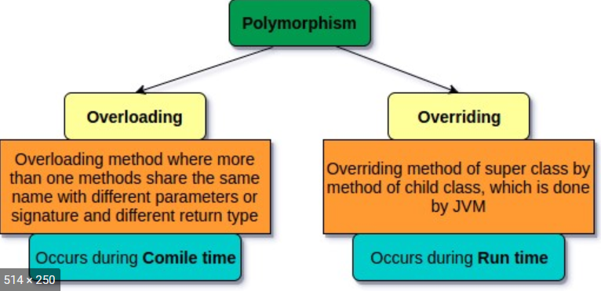
Polymorphism
Polymorphism in Java is a concept by which we can perform a single action in different ways.

Slide 18
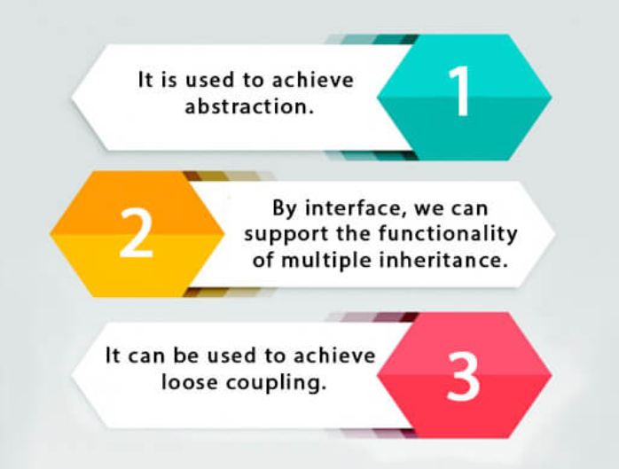
Abstraction and Interface
Abstraction is a process of hiding the implementation details and showing only functionality to the user.
The Interface in Java is a mechanism to achieve abstraction. There can be only abstract methods in the Java interface.

